Slide 1


Deforestation Detection (Fire Classification)
Name:- Laasika Reddy Anuga Student ID:- 2320040069 AICTE ID : STU6824a039374ef1747230777

Slide 2

Learning Objectives
Developing an ML-based system that can detect and classify fire incidents using satellite data.
Understanding year-wise trends and patterns using exploratory data analysis.
To preprocess and clean real-world datasets for accurate model training.
Experimenting with different algorithms (Logistic Regression, KNN, Random Forest, etc.) and compare their performance.
Deploying the best-performing model for future use in real-time forest fire monitoring.
GOAL
Source :
www.freepik.com/

Slide 3
Tools and Technology used
Tools & Platforms Used: • Google Colab – to write and run my code online • VS Code – for coding and managing project files • Python 3.x – main programming language
Libraries & Frameworks: Data Handling: pandas, numpy Visualization: matplotlib, seaborn, folium Preprocessing: StandardScaler, LabelEncoder, OneHotEncoder (sklearn), SMOTE (imbalanced-learn) Machine Learning Algorithms Used: – Logistic Regression – Decision Tree – Random Forest – K-Nearest Neighbors (KNN) – XGBoost (XGBClassifier) Model Evaluation: accuracy_score, classification_report, ConfusionMatrixDisplay

Slide 4

Methodology
Collected satellite fire datasets from 2021–2023.
Combined and cleaned the data (removed noise, handled duplicates/outliers).
Explored the data through visualizations to understand trends and patterns.
Converted categorical columns and scaled numerical features.
Balanced the dataset using SMOTE.
Split the data into training and testing sets.
Trained multiple machine learning models.
Evaluated and identified the best-performing model.
Saved the selected model for future deployment.

Slide 5
Problem Statement:
Forest fires cause massive environmental loss and contribute to large-scale deforestation. Traditional fire monitoring methods are often manual, slow, and unable to provide real-time alerts across large areas.
There is a need for an intelligent system that can automatically detect and classify fire events using satellite data to support faster response and better forest management. Example:- “Instead of waiting for someone to see smoke and report a fire, we want a machine learning model that looks at satellite data and can instantly tell whether a fire detected is normal, moderate, or severe, helping authorities act on time and reduce deforestation.”

Slide 6
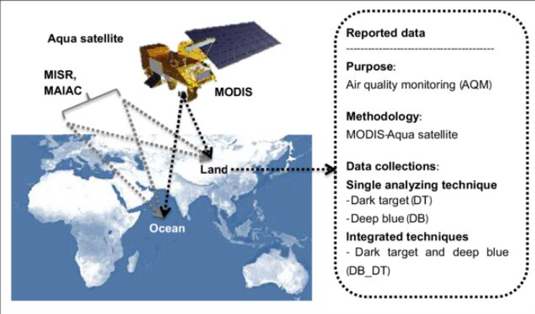
Solution:
Build a machine learning-based classification system that uses satellite fire data (MODIS) to automatically detect and categorize fire events.
Apply data cleaning, feature engineering, and visual analysis to understand fire patterns and prepare quality input for the model.
Use algorithms like Random Forest and Decision Tree to accurately classify fire based on brightness, FRP, confidence, etc.
Select and save the best-performing model so it can be used in the future for real-time monitoring of forest fires, helping reduce deforestation.
GitHub Repo:- https://github.com/laasika25/Deforestation_Detection

Slide 7
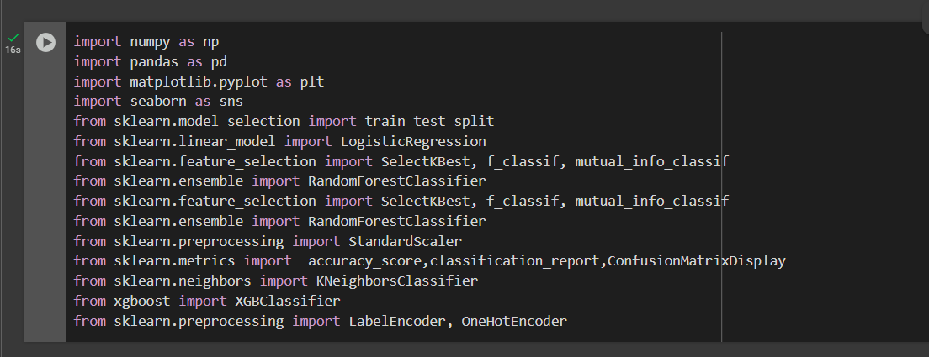
Screenshot of Output:
1) Libraries:

Slide 8
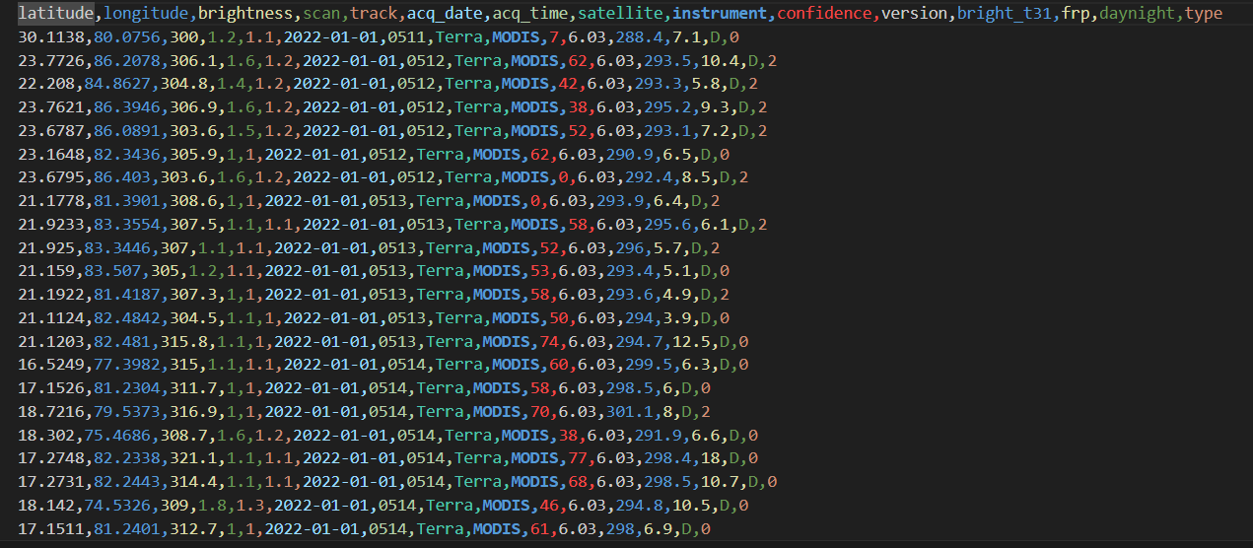
Screenshot of Output:
2) DataSet (MODIS DataSet from 2021-2023):

Slide 9
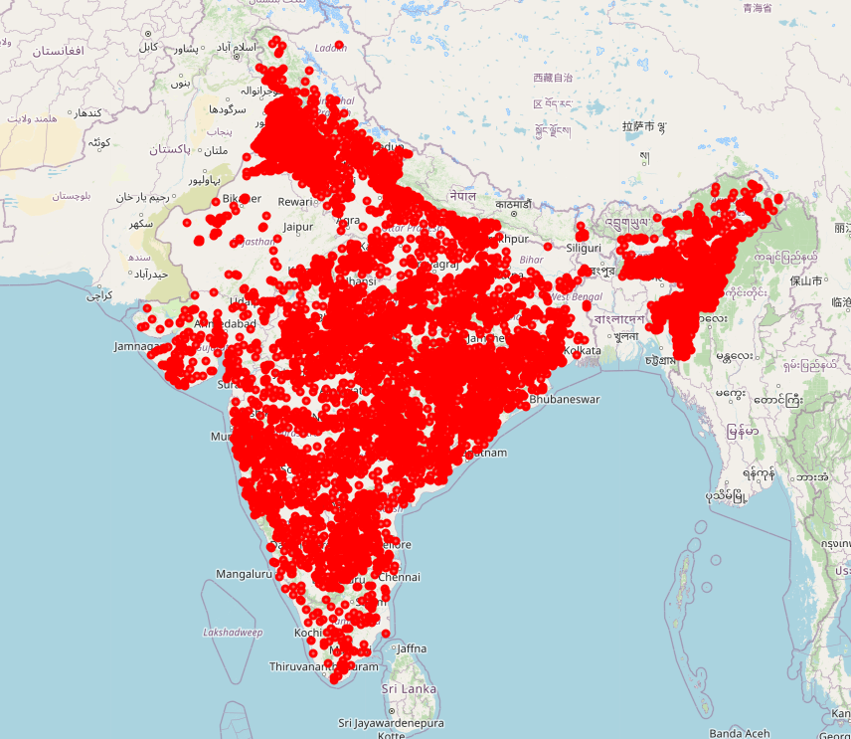
Screenshot of Output:
3) Data on Indian Map

Slide 10
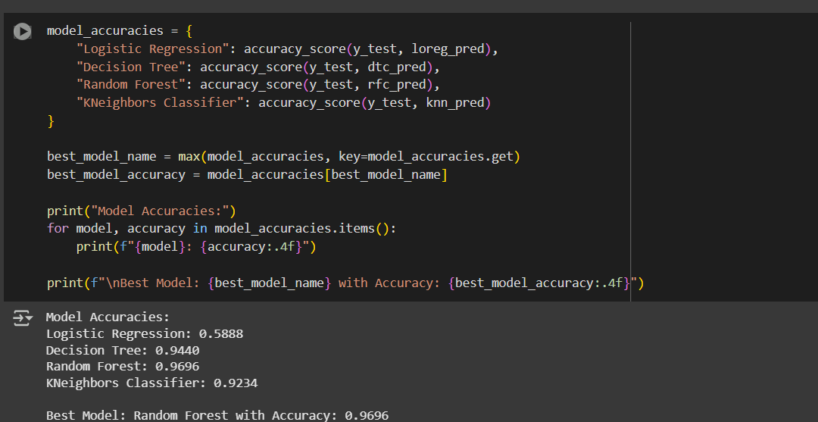
Screenshot of Output:
4) Different Alogorithms and choosing best model:-

Slide 11
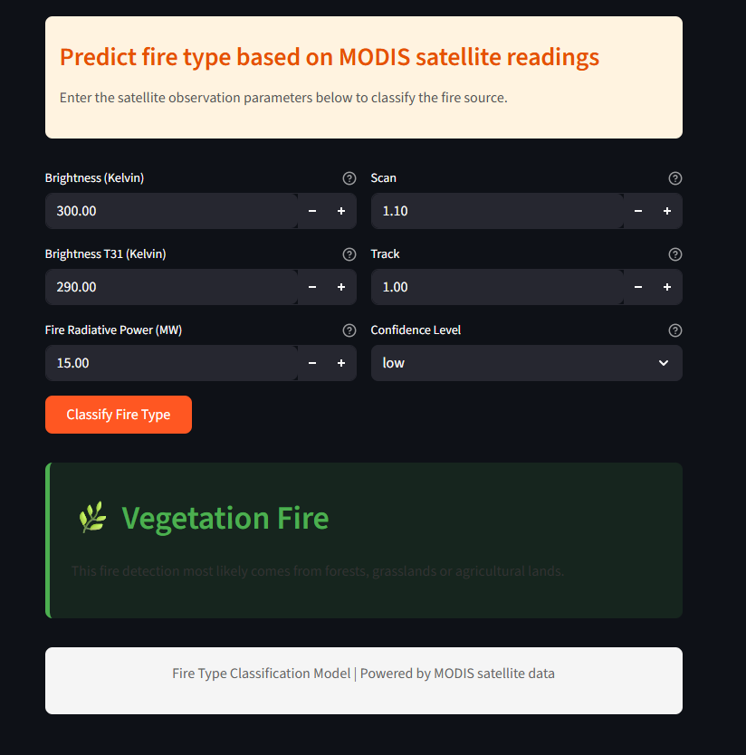
Screenshot of Output:
5) Streamlit Model:-

Slide 12
Conclusion:
Built a smart ML model using satellite data (2021–2023) to detect forest fires.
Applied cleaning, EDA, SMOTE balancing & tested multiple algorithms.
Random Forest performed the best with 96% accuracy.
Helps authorities quickly classify fire events for faster response & reduced environmental damage.
Future Scope & Improvements:
Deploy the model for real-time forest fire detection using live satellite feeds.
Integrate with mobile/web apps for instant alerts to forest officers.
Improve accuracy with deep learning models (e.g., LSTM, CNN).
Use additional data like weather, wind speed, humidity for better predictions.
Extend the model to predict fire risk zones in advance

